Slide 1
CPS-101 ICT Fundamentals
Lecture - 7
Lecturer Rabia Khan

Slide 2
NETWORKS - I

Slide 3
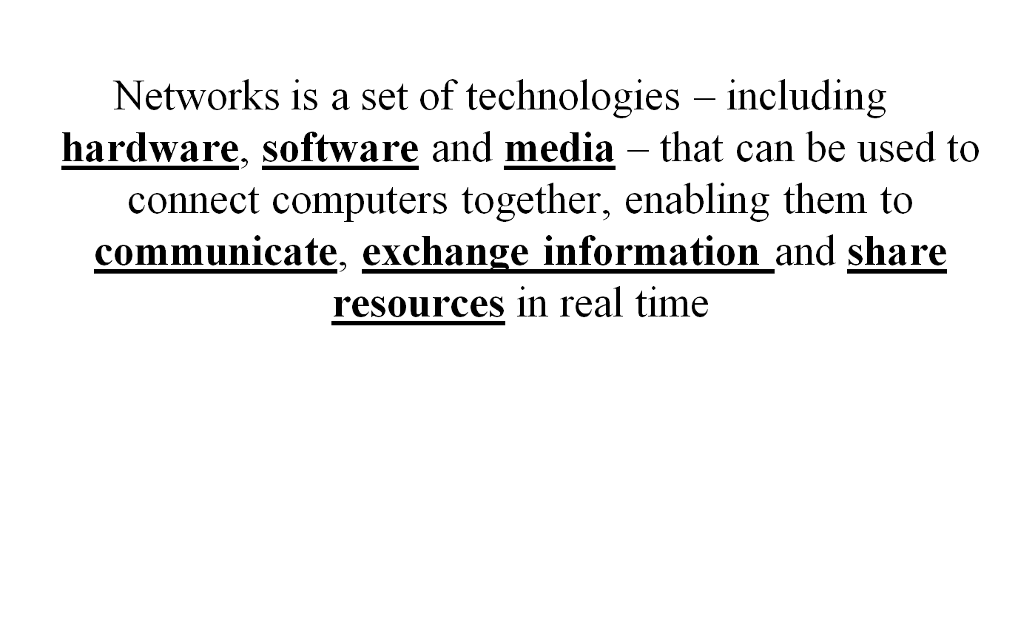
What is a Network?

Slide 4
Example
Web Browsing application
  Software
Protocols involved
  Software
NIC / Modem
  Hardware
Telephone line / Co-axial cable / Air interface
  Media

Slide 5
Why do you want to have Networks?

Slide 6
Uses of Networks
Sharing Resources
  1 printer , many people wanting to print
  For e.g. printer in CS lab
  Access to same data and programs
    Servers
Personal Communication
  Email
  Audio/Video/Data Conferencing

Slide 7
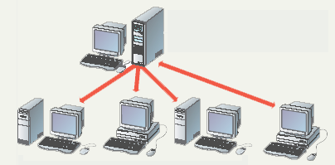
Uses of Network – Sharing Data
File server contains documents used by other computers.

Slide 8
Uses of Networks
Access to remote resources
  File downloads
Data Backups
  Shared storage device
  Regular data backup
Greater performance
  Distributed computing

Slide 9
Types of Computer Networks according to the distance between nodes
LAN: Local Area Network
WAN: Wide Area Network

Slide 10
LAN (Local Area Network)
A network of computers located in the same building or a handful of nearby buildings
Examples:
  Computer network of a University campus for e.g. computer network at MCS

Slide 11
WAN (Wide Area Network)
A network in which computers are separated by great distances, typically across cities or even continents
May consist of several interconnected LANs
Example:
  The network connecting the ATM of a bank located in various cities
  A network connecting the local and oversea offices of a SW house
  Internet

Slide 12
Assignment : 3
Following is the list of different types of networks based on physical scope. Describe each one of them with examples.
  Metropolitan Area Networks
  Campus Area Networks
  Personal Area Networks
  Global Area Networks
Submission Date : 15th Dec 2010
Submit only hand written individual assignments

Slide 13
Software part of a Network
Applications
  Email
  Browsing
  Conferencing
  Chatting (text/voice)
  File Transfer
  Audio/Video Streaming
Protocols
  Set of Rules (driving car example)
  Language that a computer uses to achieve data communication

Slide 14
Packet
The smallest unit of data transmitted over a computer network
A message to be transferred over the network is broken up into small packets by the sending computer
All packets travel independently
When all packets are received by the destination computer, it reassembles them to form the original message

Slide 15
Packet
Each packet consists of
  Header part
    Contains control info to assist in routing of the packet
    Source address
    Destination address
  Payload part
    Contains actual data
  Error control part
Header
Payload
Error Control
Packet

Slide 16
HARDWARE PART OF A NETWORK

Slide 17
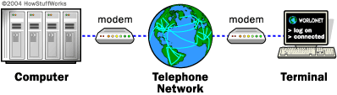
Modem
The word "modem" is a contraction of the words modulator-demodulator. A modem is typically used to send digital data over a phone line.
The sending modem modulates the data into a signal that is compatible with the phone line, and the receiving modem demodulates the signal back into digital data. Wireless modems convert digital data into radio signals and back.

Slide 18
Modem
  Modulator/DEModulator
  Computer sends data in digital form
  Modem provides a hardware interface between computer and telephone lines
  Transmission speed upto 56Kbps
  Several modem types
    Internal : An internal modem is a device installed inside a desktop computer or a laptop
    External: A modem that resides in a self-contained box outside the computer system.
    Voice: Voice generally means that the modem is capable of supporting telephone answering machine functions
    Fax: A device you can attach to a personal computer that enables you to transmit and receive electronic documents as faxes.

Slide 19
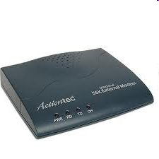
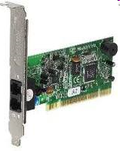
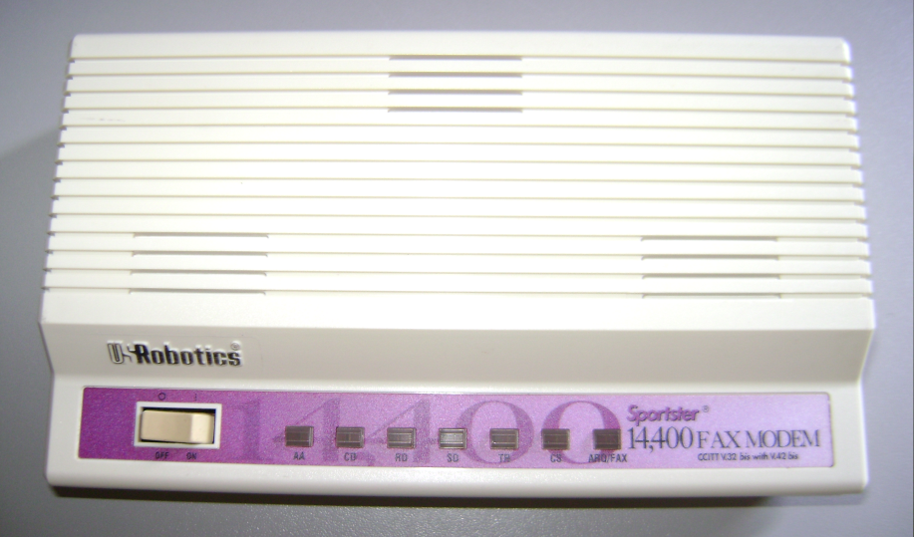
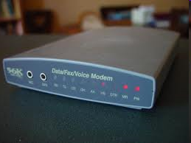
Modem
External Modem
Internal Modem
Voice Modem
Fax Modem

Slide 20
ISDN (Integrated Services Digital Network)
ISDN is a system of digital phone connections that has been designed for sending voice, video, and data simultaneously over digital phone lines
Data channels (B channel) and Control Channels (D channel)
2 Types : BRI (Basic Rate Interface), PRI (Primary Rate Interface)
  Basic Rate Interface is made up of two B channels with a bandwidth of 64 Kbit/s and a D channel with a bandwidth with 16 Kbit/s.
  Primary Rate Interface has a greater number of B channels, which varies from nation to nation across the globe, and a D channel with a bandwidth of 64 Kbit/s. (For e.g. U.S standard: 23 data channels each supporting 64 kbps, 1 control channel at 64 kbps, and Europe standard: 30 data channels each supporting 64 kbps, 2 control channel at 64 kbps)
ISDN adapter required at computer

Slide 21
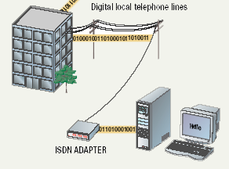
ISDN (Integrated Services Digital Network)

Slide 22
DSL (Digital Subscriber Line)
Implementation of Digital Subscriber Line technology originally was part of the Integrated Services Digital Network (ISDN) specification
Newer technology to provide better data rates over the telephone lines (No dial up!)
Several versions exist
    Different transfer rates for different version
    Asymmetrical DSL (ADSL)
      Upload speed slower than download speed
    Symmetrical DSL (SDSL)
100 Kbps to 30 Mbps

Slide 23
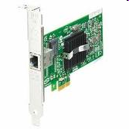
LAN Card
LAN Card or Network Interface Card (NIC)
  A LAN is a small group of computers all hooked up together. These computers are all hooked together by wires. And its the LAN card that the wire plugs into in the computer.
  Digital Interface + Protocol

Slide 24
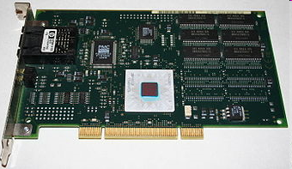
ATM (Asynchronous Transfer Mode)
  Nothing to do with money!! Not Automated Teller Machine!!
  Stands for Asynchronous Transfer Mode
  Efficient transfer of video and sound
    Real Time traffic
    Speeds on ATM Network can reach 10 Gbps!!!
  Requires a special NIC and hardware

Slide 25
Wireless LAN Card
Wireless NIC
  Transmission over air is not digital
  Provides Interface + Protocol
  IEEE 802.11
    Also called Wi-Fi
  Several versions
      802.11b connects up to 11Mbps
      802.11g connects up to 56Mbps
      802.11n connects up to 600Mbps

Slide 26
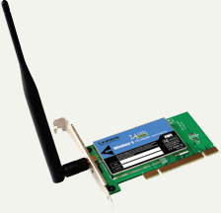
WLAN Card

Slide 27
HOW CAN WE CONNECT THESE COMPUTERS?
Now that we have some software and hardware on each computer..

Slide 28
Network Topologies
Network topology is the layout pattern of interconnections of the various elements (links, nodes, etc.) of a computer network.
Topology
  Logical layout of wires and equipment
  Choice affects
    Network performance
    Network size
    Network collision detection
  Several different types

Slide 29
Basic Types of Network Topologies
The study of network topology recognizes seven basic topologies:
  Point-to-point topology
  Bus (point-to-multipoint) topology
  Star topology
  Ring topology
  Tree topology
  Mesh topology
  Hybrid topology

Slide 30
Point-to-Point (P2P)
Computer
A
Computer
B

Slide 31
Point-to-Point (P2P)
The simplest topology is a permanent link between two endpoints.
Think of Conventional Telephony as an example of switched point to point topology.
Inexpensive
Limited connectivity
Quite often used for connecting two LANs to form a WAN

Slide 32
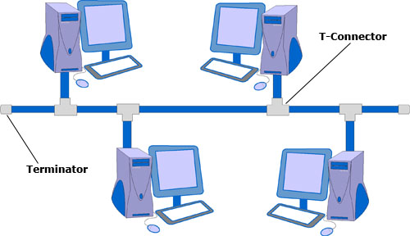
Bus Topology
Each machine is connected to a single cable. Each computer or server is connected to the single bus cable through some kind of connector.
One wire connects all nodes
Terminator ends the wires
Advantages
    Easy to setup
    Small amount of wire
Disadvantages
    Slow
    Easy to crash because a single fault can crash down the network

Slide 33
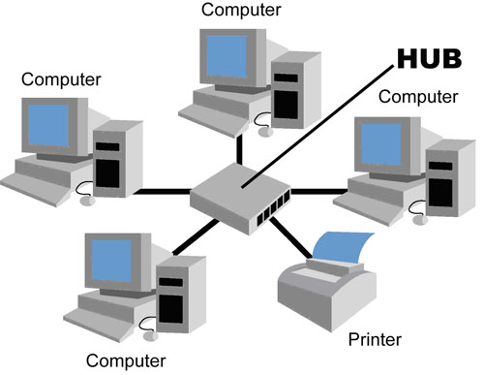
Star Topology
Each network host is connected to a central hub. In contrast to the bus topology, the star topology connects each node to the hub with a point-to-point connection.
Packets sent to hub
Hub sends packet to destination
Advantages
  Easy to setup
  One cable can not crash network
Disadvantages
  One hub crashing downs entire
  network
  Uses lots of cable
Most common topology

Slide 34
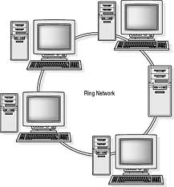
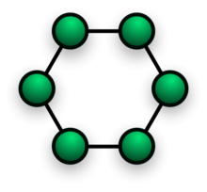
Ring Topology
Nodes connected in a circle
Tokens used to transmit data
  Nodes must wait for token to send
Advantages
  Time to send data is known
  No data collisions
Disadvantages
  Slow
  Lots of cable

Slide 35
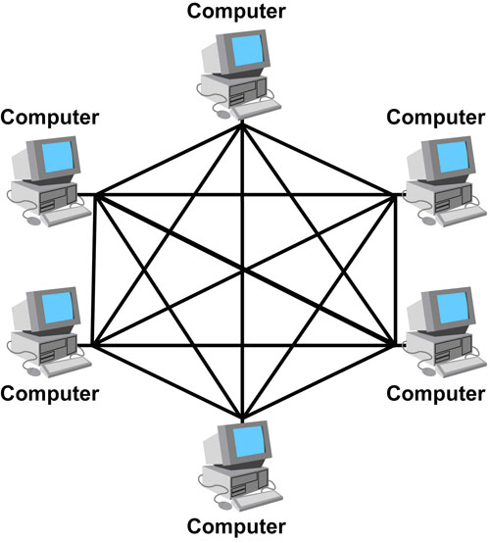
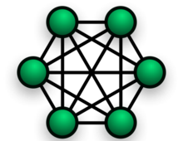
Mesh Topology
All computers connected together
Also called 'fully connected'
Internet is a mesh network
Advantage
  Data will always be delivered
  Fault tolerant
    A break in one cable doesn’t effect other connections
Disadvantages
  Lots of cable
  Hard to setup
  Too costly
  Complex

Slide 36
Linking Hardware
Computer
E
Computer
A
Linking Hardware
Computer
D
Computer
B
Computer
C

Slide 37
Types of Linking Hardware
Hubs
Bridges
Switches
Routers
Gateways

Slide 38
Hub
Functional at Layer -1
A device that is used to connect several computers to form a network
A hub has several ports. The number generally is 8, 12, 16, 24, 32, or 48
A hub contains multiple ports. When a packet arrives at one port, it is copied to the other ports so that all segments of the LAN can see all packets. So a hub is a repeater not a router!!!
In simple terms, a hub just takes the data that comes into a port and sends it out all the other ports in the hub. It doesn't perform any filtering or redirection of data among different networks.
Most dumb among all linking devices

Slide 39
Hub
Each computer in a network is connected to one of the ports through a cable
A computer wanting to send a message to one of the others in the network sends a message to the hub, which, in turn, broadcasts the message to all others connected to it

Slide 40
Bridge
Functional at Layer -2 (Data Link Layer)
Used to form a connection between two separate, but similar networks
A device that decides whether a message from you to someone else is going to the LAN in your building or to someone on the LAN in the building across the street. A bridge examines each message on a LAN, "passing" those known to be within the same LAN, and forwarding those known to be on the other interconnected LAN (or LANs).

Slide 41
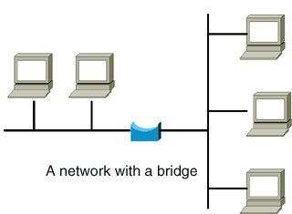
Bridge

Slide 42
Switch
Functional at Layer -2 (Data Link Layer)
Has multiple ports
Learns which machine is connected to which port
Only intended node receives transmission
Transfer data across a network segment using MAC (Media Access Control) addresses for reference
Reduces broadcast traffic

Slide 43
Router
Functional at Layer -3 (Network Layer)
Connects two or more LANs together
They are designed to calculate the best possible path for transmission of data packets between networks. The basis for routing of data through a router is the use of Internet protocol addresses.

Slide 44
Router
Examines the destination info in each arriving packet
  Routes it through the most efficient path available
Either delivers the packet to the destination computer across a local network
OR forwards the packet to another router that is closer to the final destination

Slide 45
Gateway
A special-purpose computer that connects and translates between networks that use different communications protocols
LAN’s may use a gateway (or router) to connect to the Internet

Slide 46
NETWORK MEDIA
How to Connect?

Slide 47
Network Media
Links that connect nodes
Choice impacts
  Speed
  Security
  Size

Slide 48
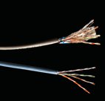
Wire Based Media
Twisted-pair cabling
  Most common LAN cable
  Called Cat5 or 100BaseT
  Four pairs of copper cable twisted
  May be shielded from interference
  Speeds range from
  1 Mbps to 1,000 Mbps
9A-<number>
Notes:
Interference is usually electrical. Magnets, solar flares or electronic devices generate interference.

Slide 49
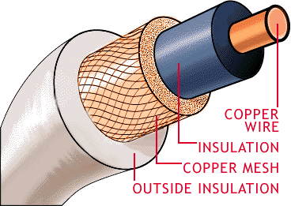
Wire Based Media
Coaxial cable
  Similar to cable TV wire
  One wire runs through cable
  Shielded from interference
  Speeds up to 10 Mbps
  Nearly obsolete
9A-<number>

Slide 50
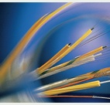
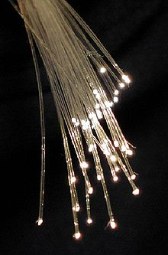
Wire Based Media
Fiber-optic cable
  Data is transmitted with light pulses
  Glass strand instead of cable
  Immune to interference
  Very secure
  Speeds up to 100 Gbps
9A-<number>

Slide 51
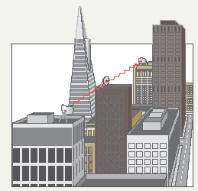
Wireless Media
Data transmitted through the air
LANs use radio waves
WANs use microwave signals
Easy to setup
Difficult to secure
9A-<number>
Notes:
Teaching tip
Now is the time to briefly discuss 802.11 standards. A full discussion of 802.11 is covered in the next section.

Slide 52
END OF LECTURE

